Slide 1


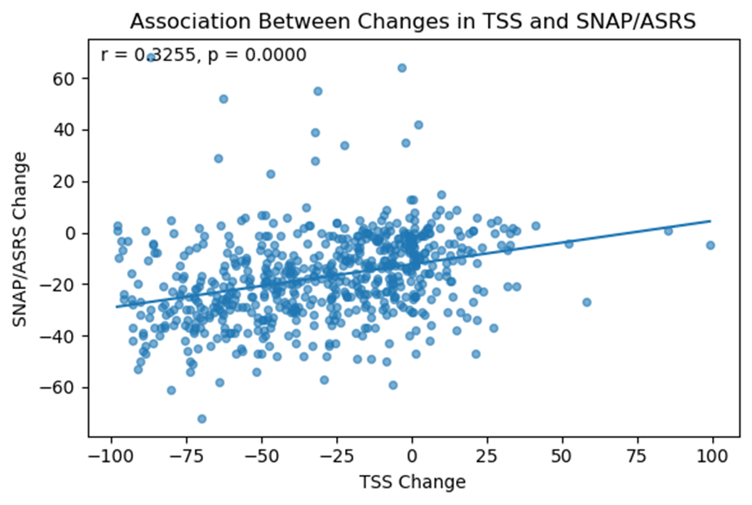
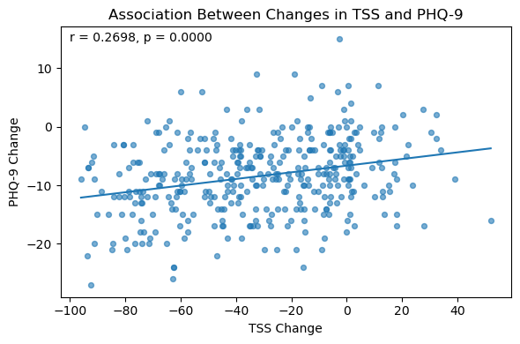
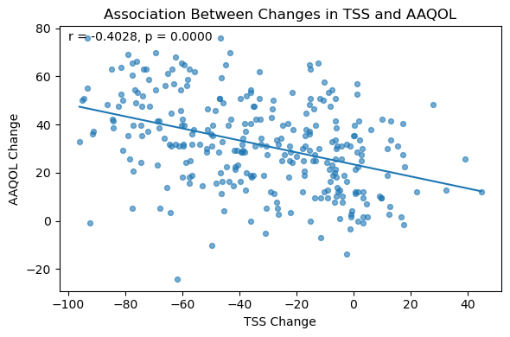
Objective ADHD Improvements Align with Patient-Reported Outcomes following Remote Treatment Pathway
Robert Nolen¹, Ragini Sanyal¹, Simon Larsson² , Nuria Casals², Tom Murdoch³, Rebecca Whelan³, Mikkel Hansen² , Phil Anderton³
¹ Qbtech, Inc., Houston, United States
² Qbtech AB, Stockholm, Sweden
³ADHD 360, Lincolnshire, United Kingdom
Introduction |  |  |  |  | Results
ADHD 360 is an innovative, evidence-based digital healthcare service in the United Kingdom that supports those with Attention-Deficit/Hyperactivity Disorder (ADHD) by providing a comprehensive assessment, diagnosis and treatment service for monitoring and managing symptoms. ADHD 360 is designed to innovate ADHD service delivery by integrating scalable, person-centered care solutions that respond to ongoing concerns about accessibility, consistency, and quality within the worldwide context of mental health services. ADHD 360 incorporated QbCheck, a standardized, objective ADHD assessment tool, into their remote clinical workflow to reduce reliance on subjective symptom reporting, enhance diagnostic accuracy, and optimize clinician time without compromising assessment quality. Given the necessity for robust, efficient, and scalable assessment pathways, QbCheck was utilized to collect objective symptom data remotely, providing clinicians with quantifiable metrics to inform diagnostic interviews and subsequent treatment planning. The purpose of this investigation was to evaluate the effectiveness of treatment and the utility of QbCheck in a remote setting, and to test whether improvements in QbCheck-derived objective ADHD metrics were associated with improvements in patient health and well-being. |  |  |  |  | All subjects (aged 6-60, mean age 31.9 years, 55.5% females) (Table 1) were diagnosed with ADHD (N=994) and then prescribed and optimized on stimulant ADHD medication prior to the second QbCheck assessment. The median time between QbCheck baseline to follow-up was 148.84 days (range 15-524 days). Following treatment, QbCheck TSS improved by 41.2% relative to baseline TSS (p<0.001). Significant improvements in patient well-being were observed at follow-up, including reduction in PHQ-9 and GAD-7 (p<0.001) as well as improvements in quality of life (p<0.001). A significant reduction of alcohol and nicotine dependence was also found from baseline to follow-up (p<0.001) (Table 2). Sample sizes varied based on completeness of assessments. There was a statistically significant correlation with change in TSS alongside change in SNAP/ASRS (r=0.3255, p<0.001), change in PHQ-9 (r=0.2698, p<0.001) and change in AAQoL (r=-0.4028, p<0.001) (Table 3, Figures 1-3). No significant correlation was found in change of TSS versus change in GAD-7, change in dependency of alcohol or change in nicotine use.
Methods
This dataset was collected from routine QbCheck assessments that were completed as part of the ADHD360 healthcare model in the United Kingdom (Sept 2023-June 2025). The first QbCheck was administered at baseline, prior to receiving a diagnosis or treatment. The second QbCheck was administered once the patient had been diagnosed and optimized on ADHD medication, following their standardized clinical care flow. Five parameters were calculated (from QbCheck) to measure Inattention, Impulsivity, and Hyperactivity, which form the calculation of a Total Symptom Score (TSS, range from 0 to 100), the probability of having ADHD symptoms. All patients were given the SNAP/ASRS (ADHD rating scales for children/ adolescents and adults), PHQ-9 (patient health questionnaire), AAQoL (quality of life questionnaire), and GAD-7 (anxiety scale) to assess self-reported symptoms. The use of alcohol and nicotine were also reported. The post-hoc analysis evaluated the changes in test variables and scores from their baseline and post-treatment optimization visit.
Conclusions
These data shows that proper treatment and management of ADHD symptoms is associated with better patient-reported health and well-being as well as in quality of life, as evidenced by the significant correlations between changes in objective ADHD performance (measured by QbCheck) and changes on validated mental health and substance use questionnaires.
Variable | N=994 | Mean Baseline (SD) | Mean Follow-up (SD) | Mean Change (SD) | P-value | Effect size (Cohens’d)
TSS | 994 | 77.73 (22.22) | 45.64 (32.50) | -32.09 (32.00) | p<0.001 | -1.00
SNAP/ASRS | 633 | 51.65 (18.11) | 34.30 (16.38) | -17.36 (16.82) | p<0.001 | -1.03
PHQ-9 | 371 | 15.38 (6.45) | 6.94 (5.87) | -8.44 (6.53) | p<0.001 | -1.29
AAQoL | 293 | 34.03 (14.40) | 65.67 (18.96) | 31.64 (18.76) | p<0.001 | 1.69
GAD-7 | 64 | 9.78 (5.46) | 4.89 (5.19) | -4.89 (6.52) | p<0.001 | -0.75
Alcohol | 404 | 6.80 (5.62) | 4.90 (4.46) | -1.90 (3.89) | p<0.001 | -0.49
Nicotine | 148 | 2.28 (1.80) | 1.78 (1.68) | -0.50 (1.80) | p<0.001 | -0.27
N | N=994
Age (Years)
Mean | 31.9
Median | 32.3
SD | 11.3
Min | 6
Max | 60
Sex
Male | n=442 (44.5%)
Female | n=552 (55.5%)
Age group
Child (6-11 years) | n=28 (2.8%)
Adult (12-60 years) | n=966 (97.2%)
Table 2. Mean (SD) and effect size of TSS (QbCheck), and different Questionnaire variables, at baseline and follow-up.
​Variable | N | Pearson correlation (changes in TSS and changes in Variable)
SNAP/ASRS | 633 | 0.3255 (p<0.001)​
​PHQ-9 | 371 | 0.2698 (p<0.001)​
AAQoL | 293 | -0.4028 (p<0.001)
Table 1: Demographics.
Table 3: Pearson correlation between change in TSS and change in each questionnaire variable.
Figure 1. Scatterplots and regression line between changes in TSS (x-axis) and changes in SNAP/ASRS (y-axis) (n=633)
Figure 2. Scatterplots and regression line between changes in TSS (x-axis) and changes in PHQ-9 (y-axis) (n=371)
Figure 3. Scatterplot and regression line between changes in TSS (x-axis) and changes in AAQoL (y-axis) (n=293)

